Slide 1
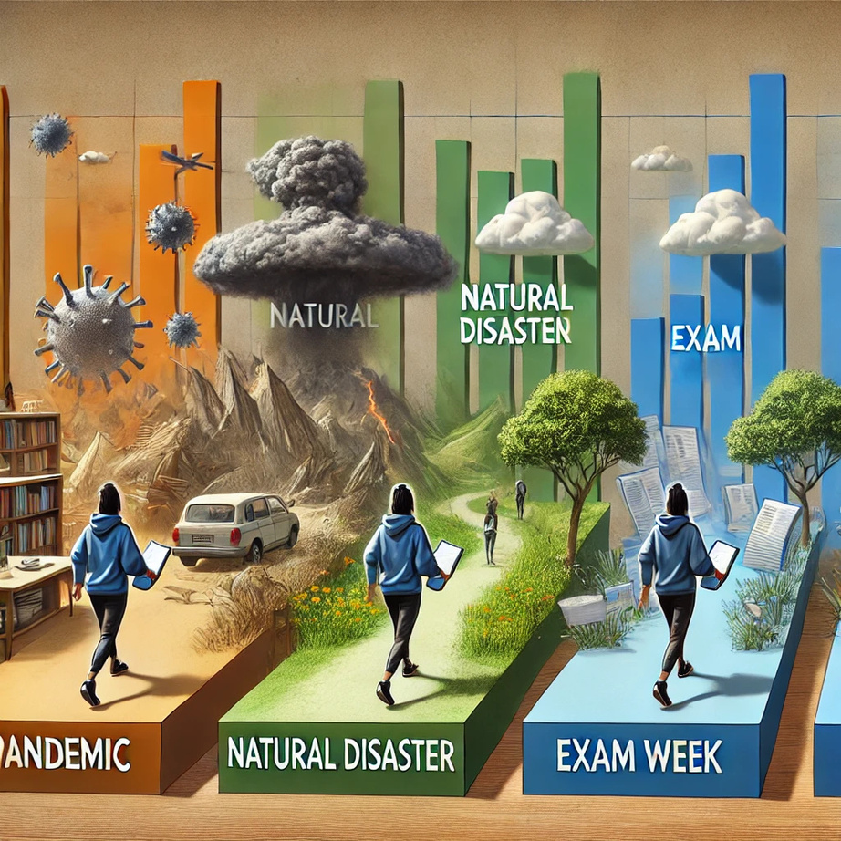
EFFECT OF UNEXPECTED CONDITIONS ON MY DAILY STEP COUNT
OĞUZHAN KELEŞ 30928

Slide 2

MY DATA SET
Apple Health

Slide 3
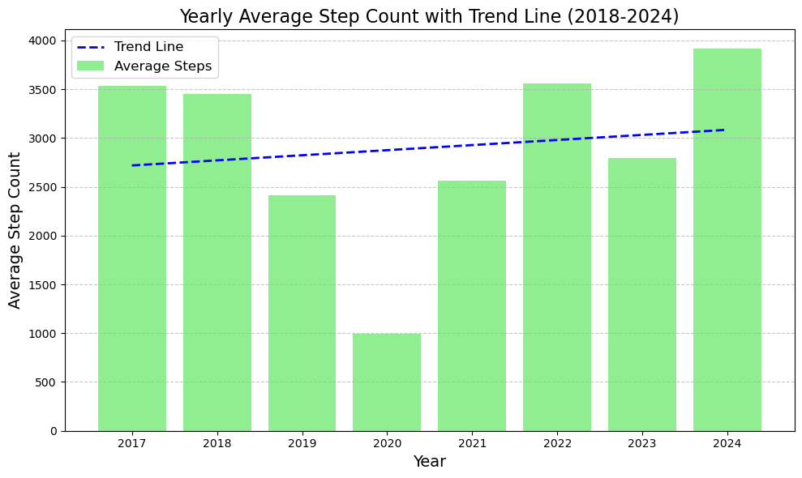
Insight into My Yearly Physical Activity Patterns
The chart shows a gradual increase in average yearly step counts from 2018 to 2024, with a noticeable dip in 2020 likely due to external factors, suggesting an overall upward trend in physical activity levels over the years.

Slide 4
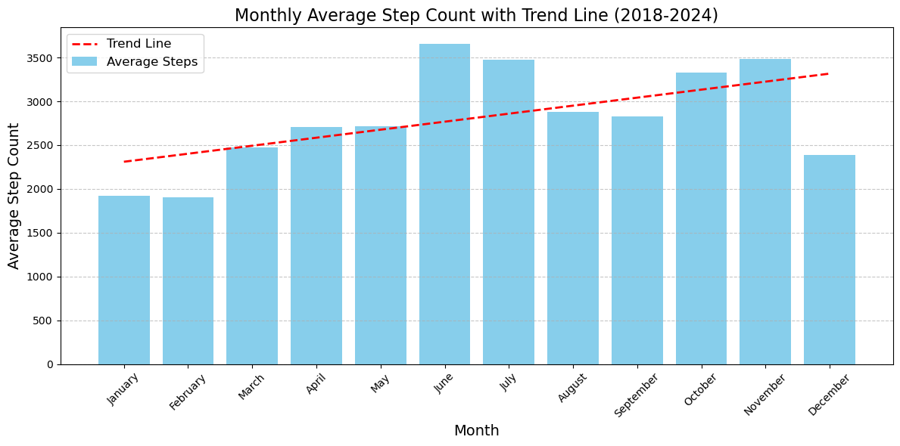
Insight into My Mothly Physical Activity Patterns
The chart suggests a seasonal trend in activity, with lower step counts during the winter months (January and December) and higher activity levels in the summer months, peaking in June and July.

Slide 5
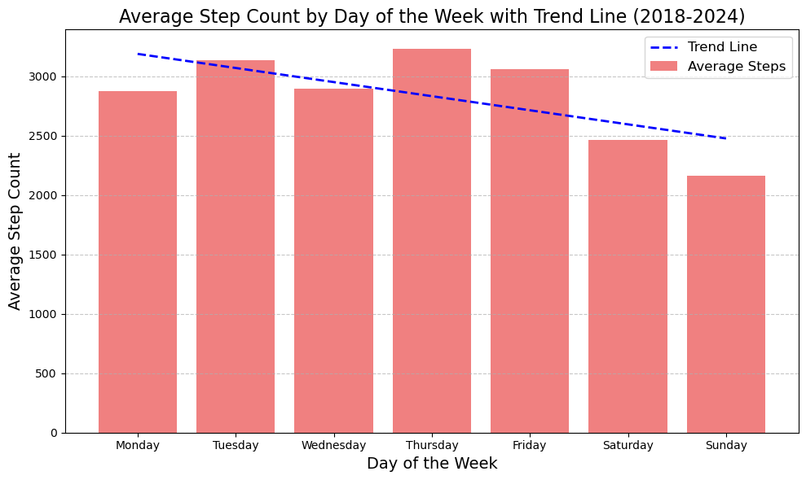
Insight into My Weakly Physical Activity Patterns
The chart indicates a decline in step counts as the week progresses, with the highest activity on Tuesday and Thursday, and the lowest on Sunday, suggesting a more active routine on weekdays compared to weekends.

Slide 6
HYPOTHESES
Null Hypothesis: Specific time periods, such as the COVID-19 pandemic, final exam weeks, or the earthquake in Turkey, have no significant negative impact on my daily physical activity as measured by step count.
Alternative Hypothesis: Specific time periods, such as the COVID-19 pandemic, final exam weeks, or the earthquake in Turkey, have a significant negative impact on my daily physical activity as measured by step count.

Slide 7
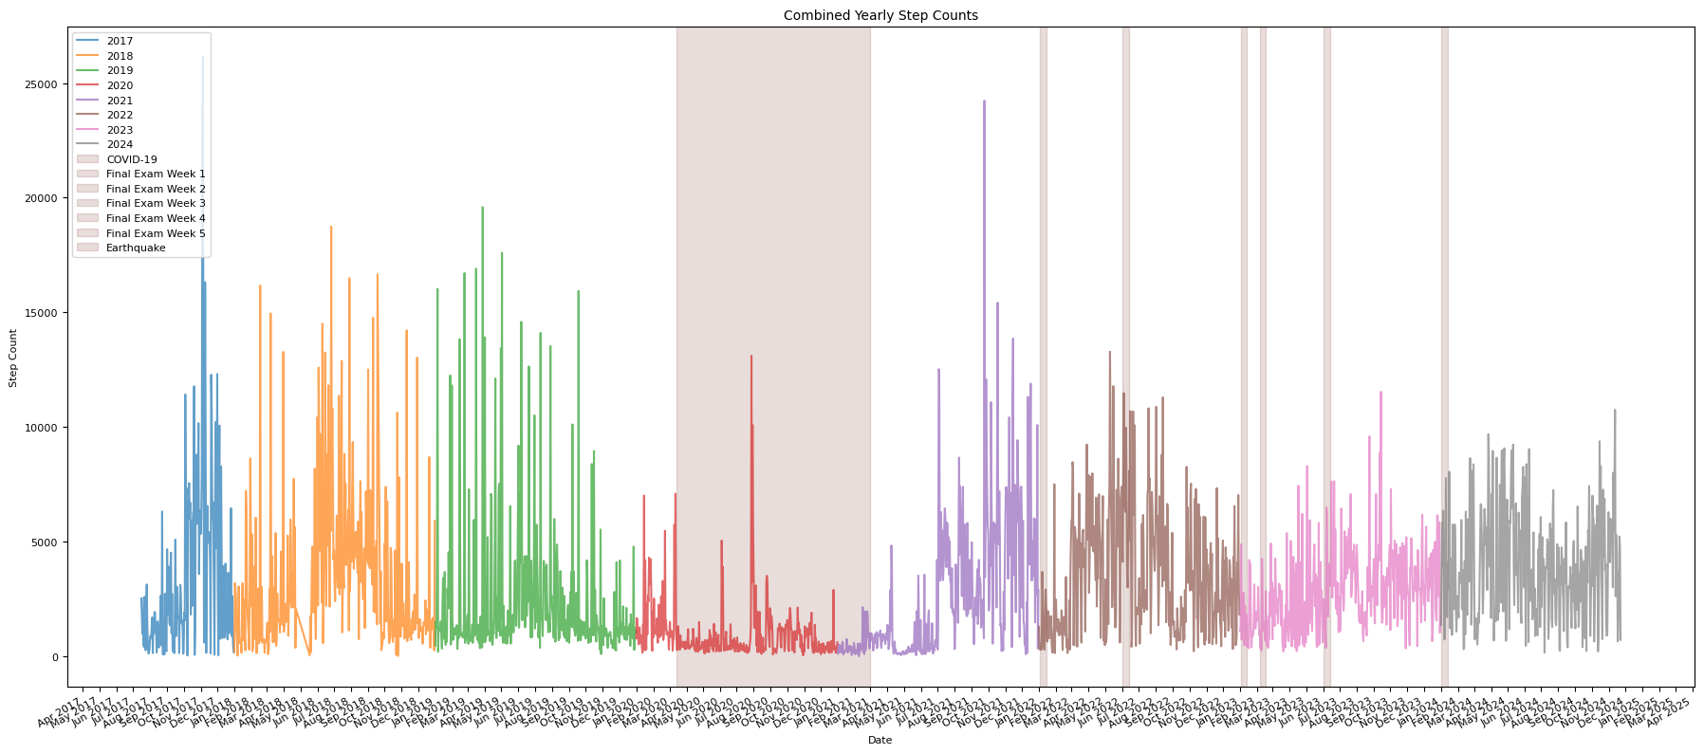
Firstly, I parse the XML file to extract step count records. Based on the extracted data, I create a yearly graph to visualize step count trends over time.

Slide 8
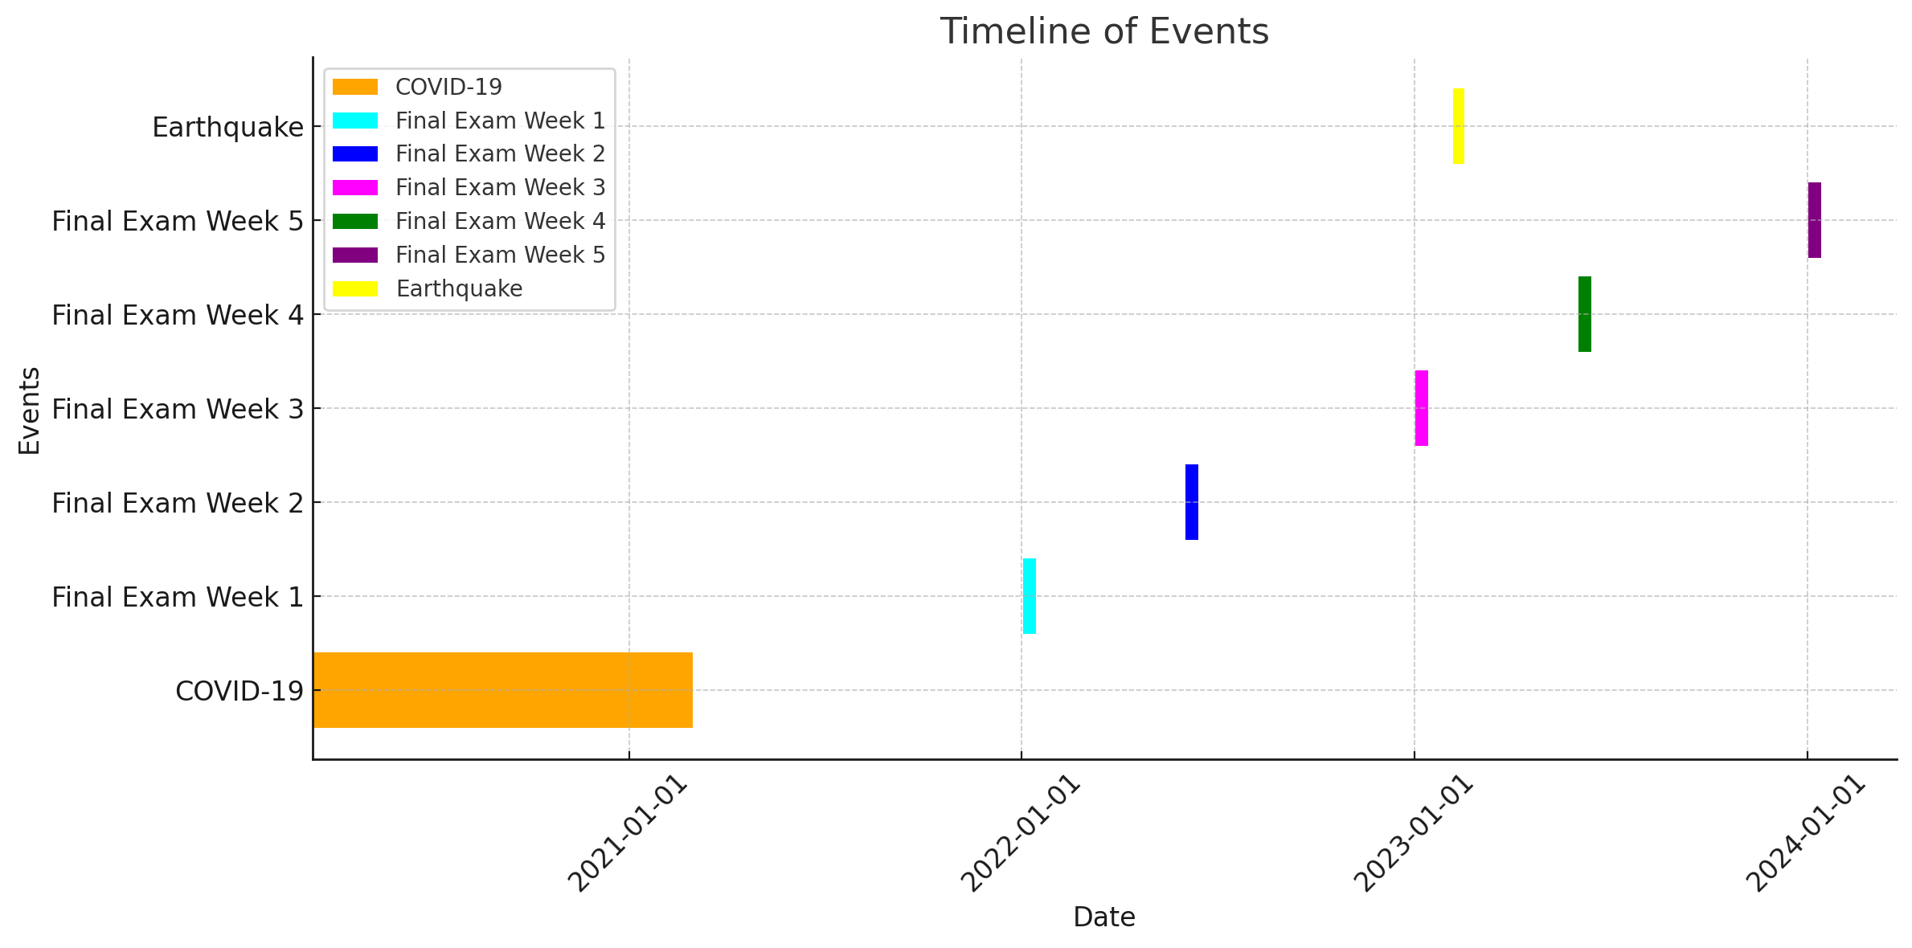
Specific time periods, such as the COVID-19 pandemic, final exam weeks, or the earthquake in Turkey, were defined in the model to highlight unexpected events and the data will be analyzed accordingly.

Slide 9
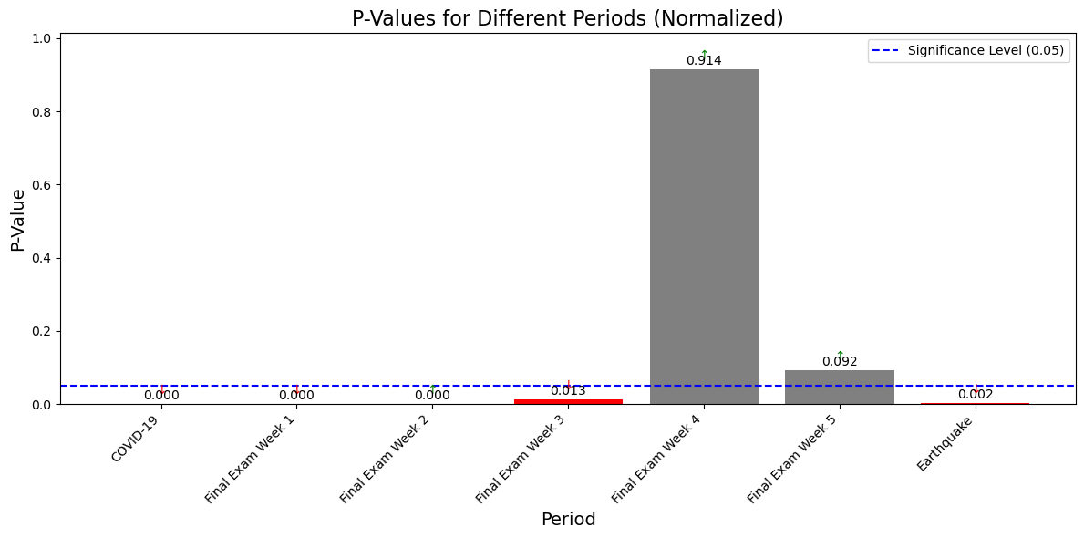
I normalize the data to calculate the p-values for each period. Based on the results, I identify that the COVID-19, Earthquake and some final periods had a statistically significant negative impact on daily physical activity, while the other periods did not show such effects.

Slide 10
IN CONCLUSION
COVID-19 and Earthquake
I rejected the null hypothesis for the COVID-19, Earthquake and some final exam periods. These periods had a statistically significant negative impact on my daily physical activity, as indicated by the p-values.
Final Exam Weeks
I failed to reject the null hypothesis for final exam week 4 and 5 . These periods did not show any statistically significant negative impact on my daily physical activity, as indicated by their respective p-values.

Slide 11
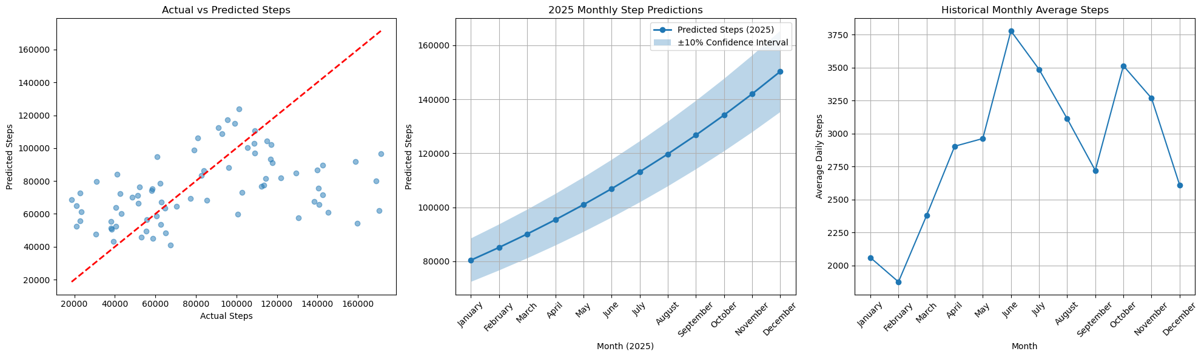
Prediction About The Future With ML Models
Model Performance on Training Data: MSE = 1530159014.42, R² = 0.12
This set of charts analyzes monthly step data by removing outliers using Z-scores, excludes the COVID-19 period, and applies linear regression to predict 2025 step counts, visualizing actual vs. predicted values, confidence intervals, and historical trends.

Slide 12
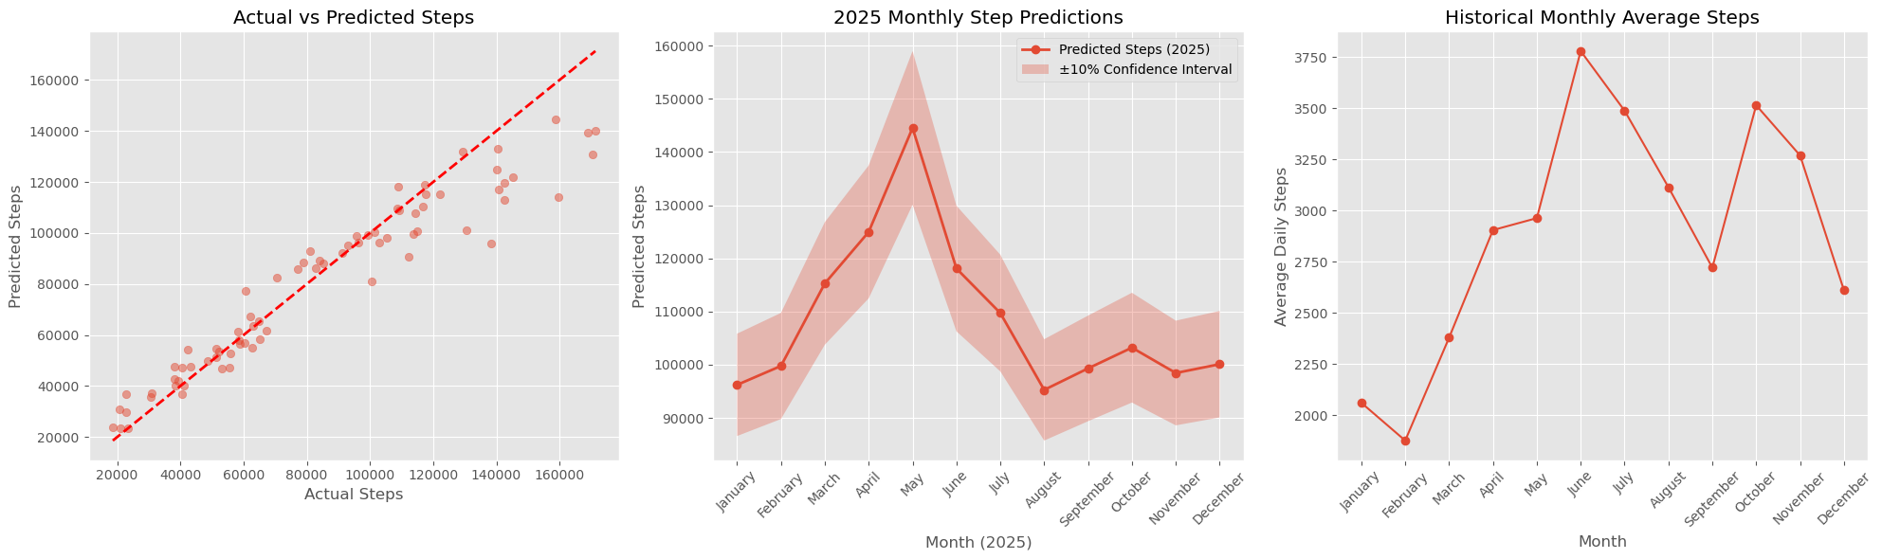
Prediction About The Future With ML Models
Model Performance on Training Data: MSE = 192345397.23, R² = 0.89
This set of charts analyzes step data using the Random Forest method, providing predictions for 2025 alongside a confidence interval, while comparing actual and predicted values and showcasing historical monthly trends to highlight seasonal variations in activity levels.

Slide 13
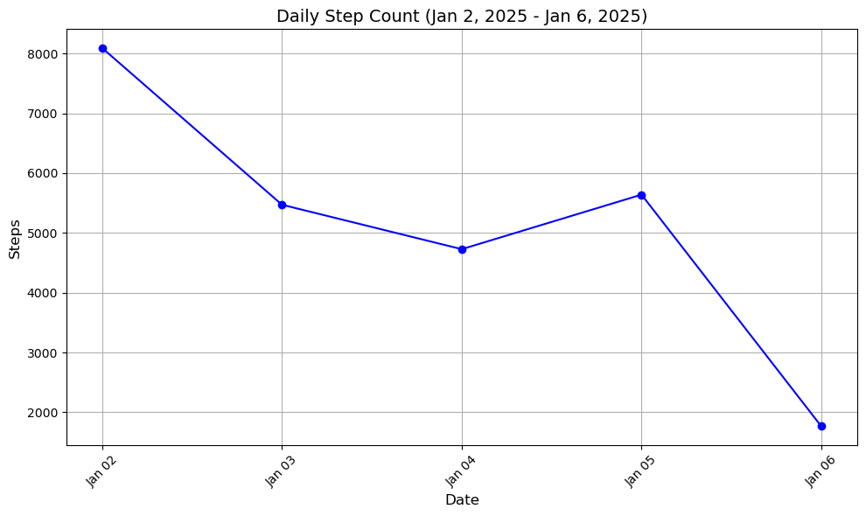
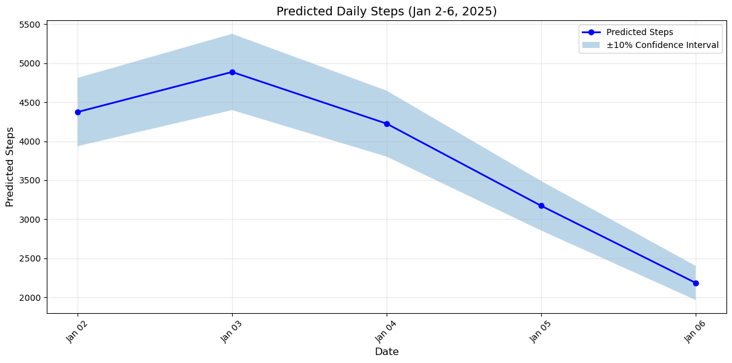
A Comparative Analysis of Predicted and Actual Data for Final Exam Week
Compared to the predictions, I was actually more active at the beginning of the week, with my step count being higher on January 2 and 3 than what was predicted. As the week went on, the predicted steps continued to decrease, but my actual step count on January 6 was much lower than predicted, showing a bigger drop than expected.

Slide 14
Final Insights and Learnings from My Data Set
From the analysis of my physical activity patterns, I can draw several key insights. The COVID-19 pandemic, similar to the null hypothesis testing, had a notable negative impact on my daily physical activity, confirming that external factors significantly altered my routine. Additionally, my activity levels follow a clear seasonal pattern, with reduced movement during the winter months and an increase in the warmer summer months. I must consider this when planning my activity goals, especially during colder periods.
Reflecting on the final exam weeks, although my activity didn't show a statistically significant drop as expected, it is clear that during stressful times, such as exams, my physical activity may still decline, even without an evident drastic impact. This shows the importance of maintaining regular exercise routines to avoid disruptions during stressful periods. Going forward, I will need to be more mindful of these trends and plan my physical activities to ensure consistency, regardless of the season or external factors like exams or stressful events.

